Slide 1
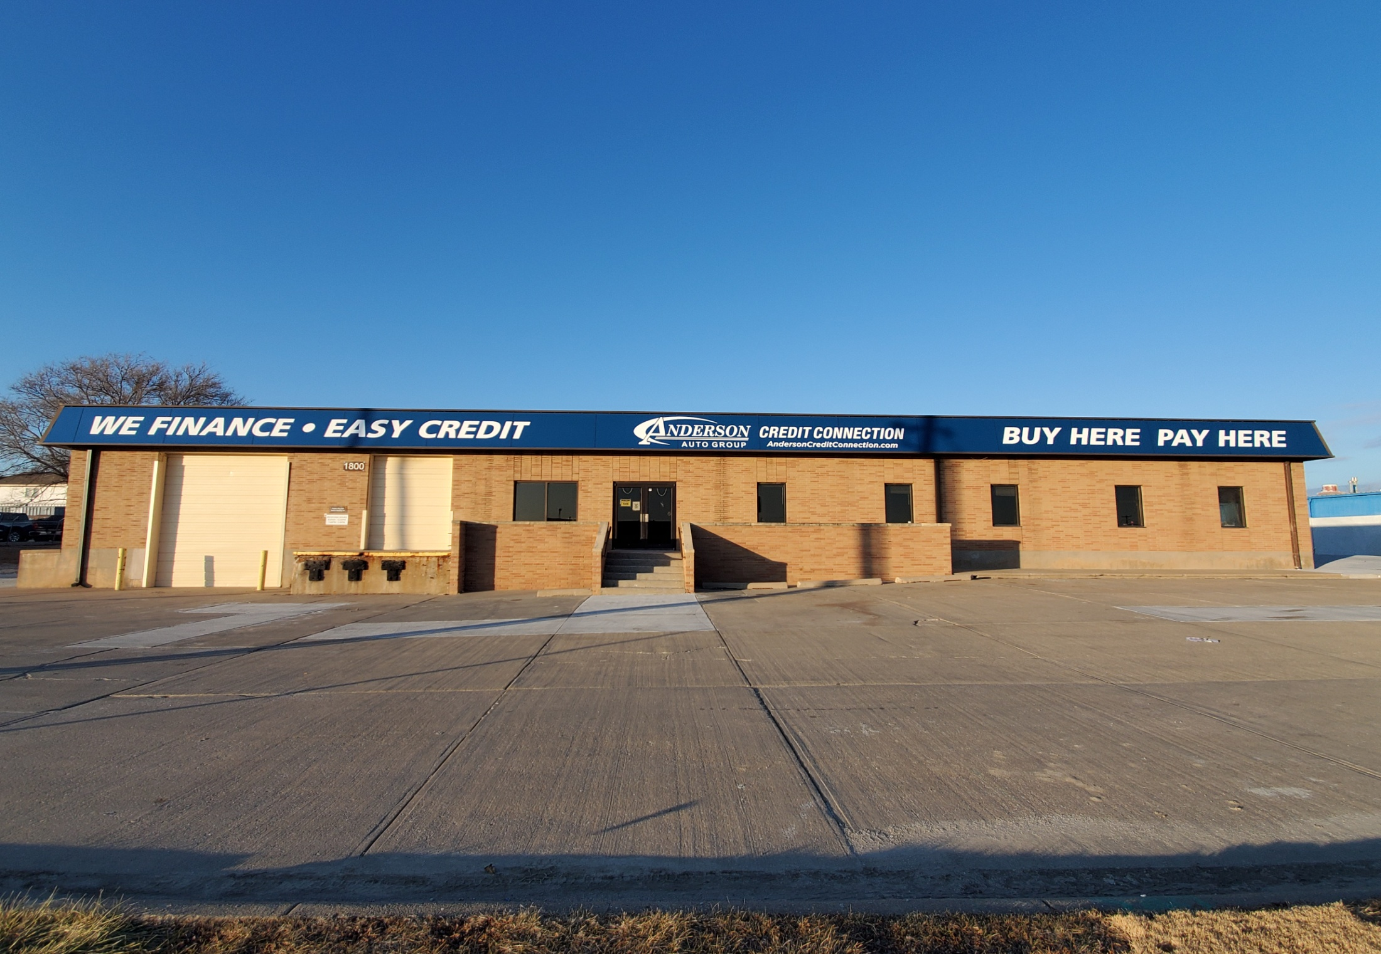
Anderson “Buy Here Pay Here” A Better Way to Buy
It’s official we are Moving on Wednesday April 22nd,
to our New Location at 1800 Adams

Slide 2
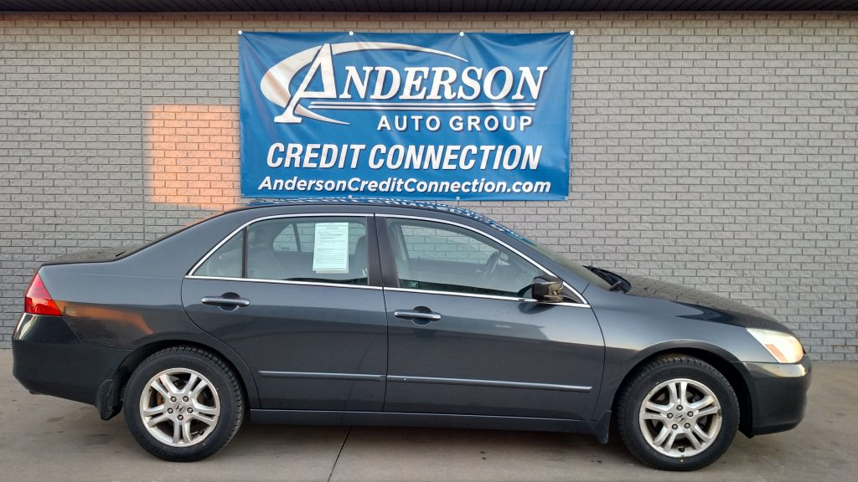
Anderson “Buy Here Pay Here” A Better Way to Buy
2007 Honda Accord
127,952 miles
$500 Down
All vehicles are inspected and repaired, by a Certified Used Car Technician

Slide 3
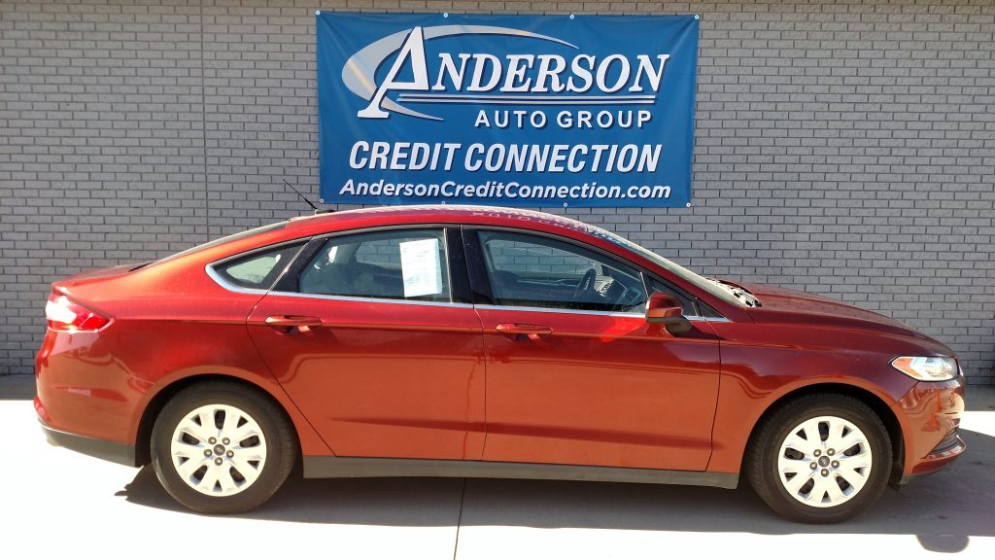
Anderson “Buy Here Pay Here” A Better Way to Buy
2014 Ford Fusion
83,861 miles
$1500 Down
All vehicles come with a 12 month/12,000 mile limited powertrain warranty

Slide 4
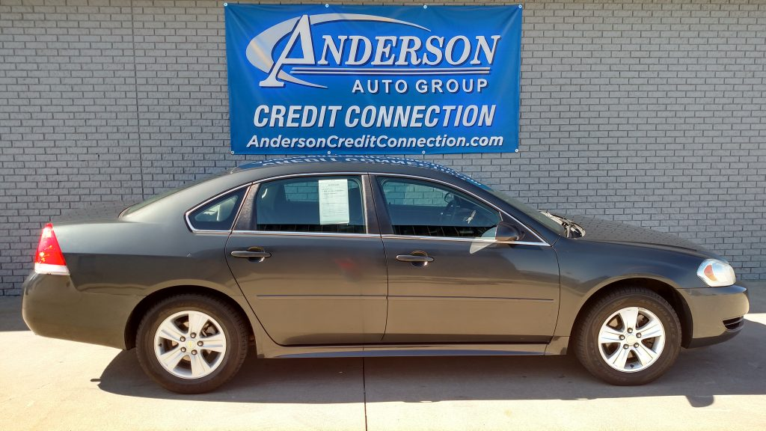
Anderson “Buy Here Pay Here” A Better Way to Buy
2015 Chevy Impala
84,677 miles
$1000 Down
We Report Credit to all THREE MAJOR CREDIT BUREAUS

Slide 5
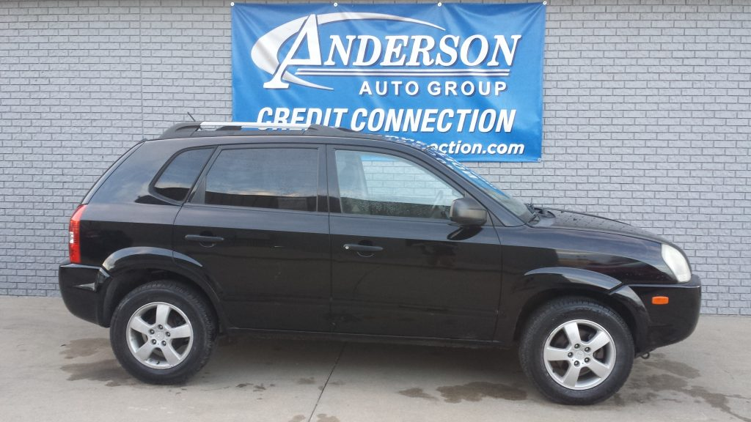
Anderson “Buy Here Pay Here” A Better Way to Buy
2007 Hyundai Tucson
75,355 miles
$500 Down
Easy Online Payment System, “Buy Here Pay from Anywhere”

Slide 6
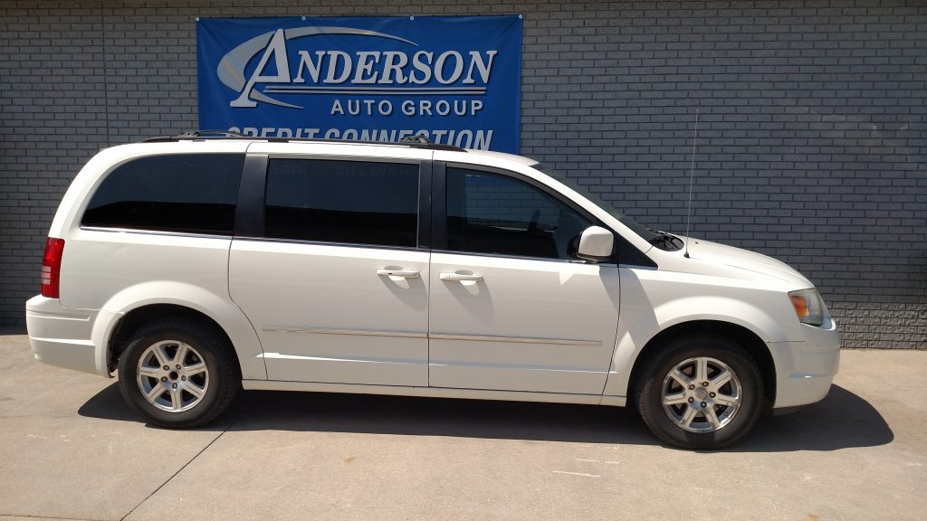
Anderson “Buy Here Pay Here” A Better Way to Buy
2009 Chrysler T&C
127,509 miles
$1000 Down
If you have the down payment and the income, we can help

Slide 7
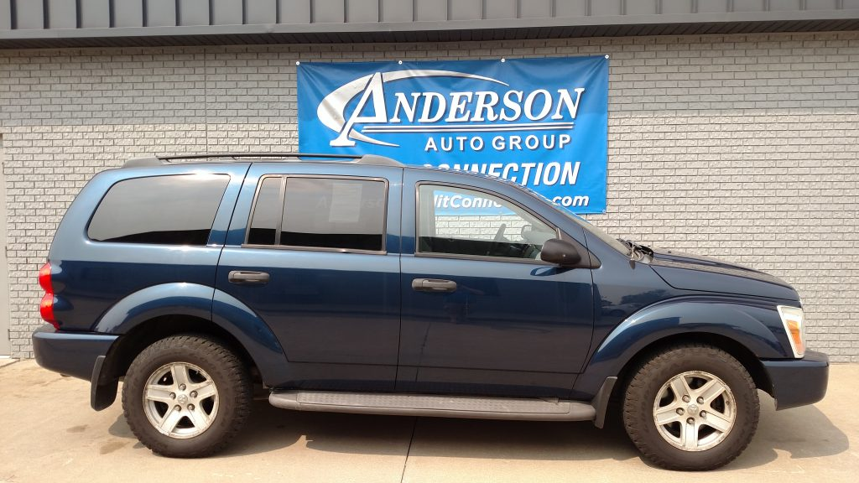
Anderson “Buy Here Pay Here” A Better Way to Buy
2006 Dodge Durango
132,509 miles
$1000 Down
Use your Tax Refund as your down payment and we can help

Slide 8
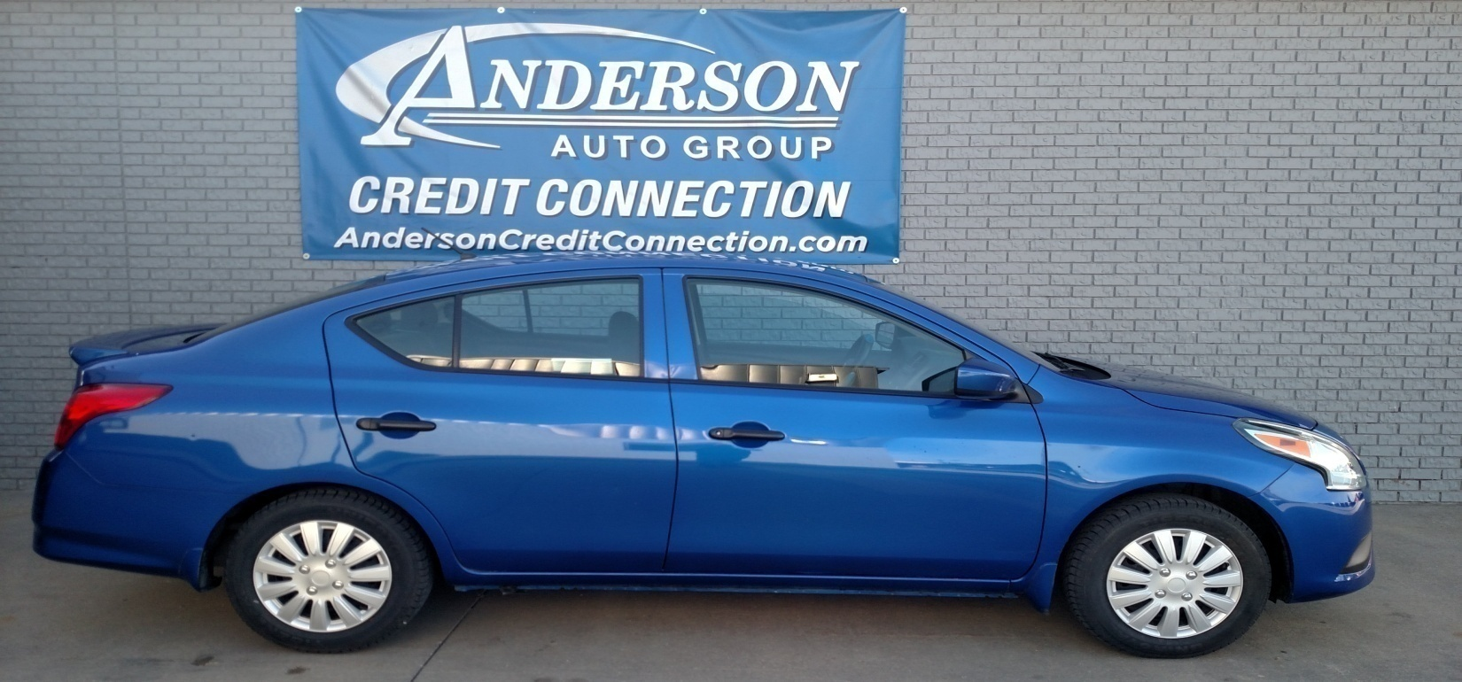
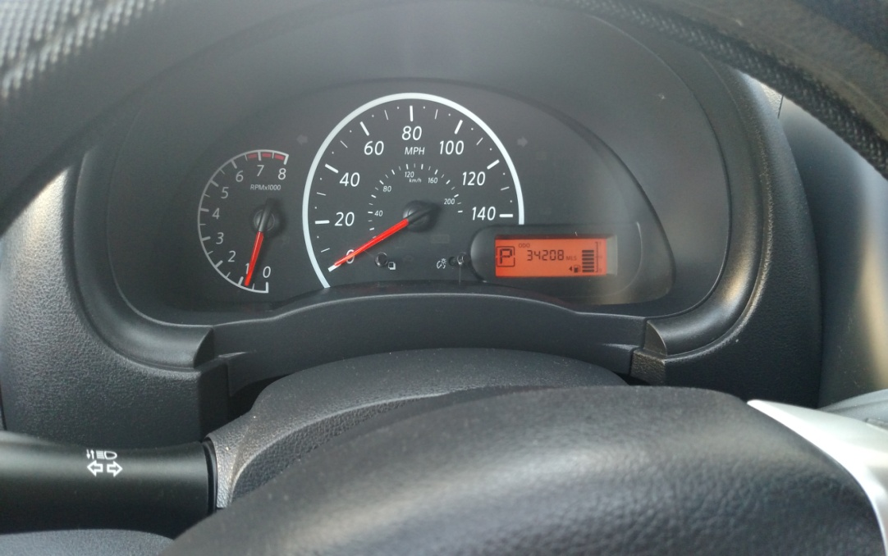
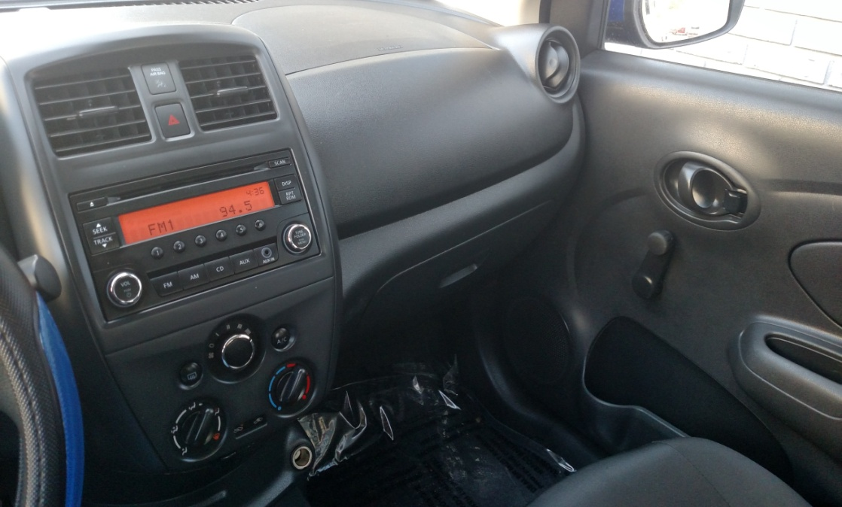
Anderson “Buy Here Pay Here” A Better Way to Buy
2017 Nissan Versa
Low Miles 34,208
Low Down $500
Low Payments
New Lower Price, Lower Down, Lower Payments

Slide 9

Anderson “Buy Here Pay Here” A Better Way to Buy
2007 Honda Accord
127,962 Miles
Ask About our Summer Special’s
Lower Price, Lower Down, Lower Payments

Slide 10
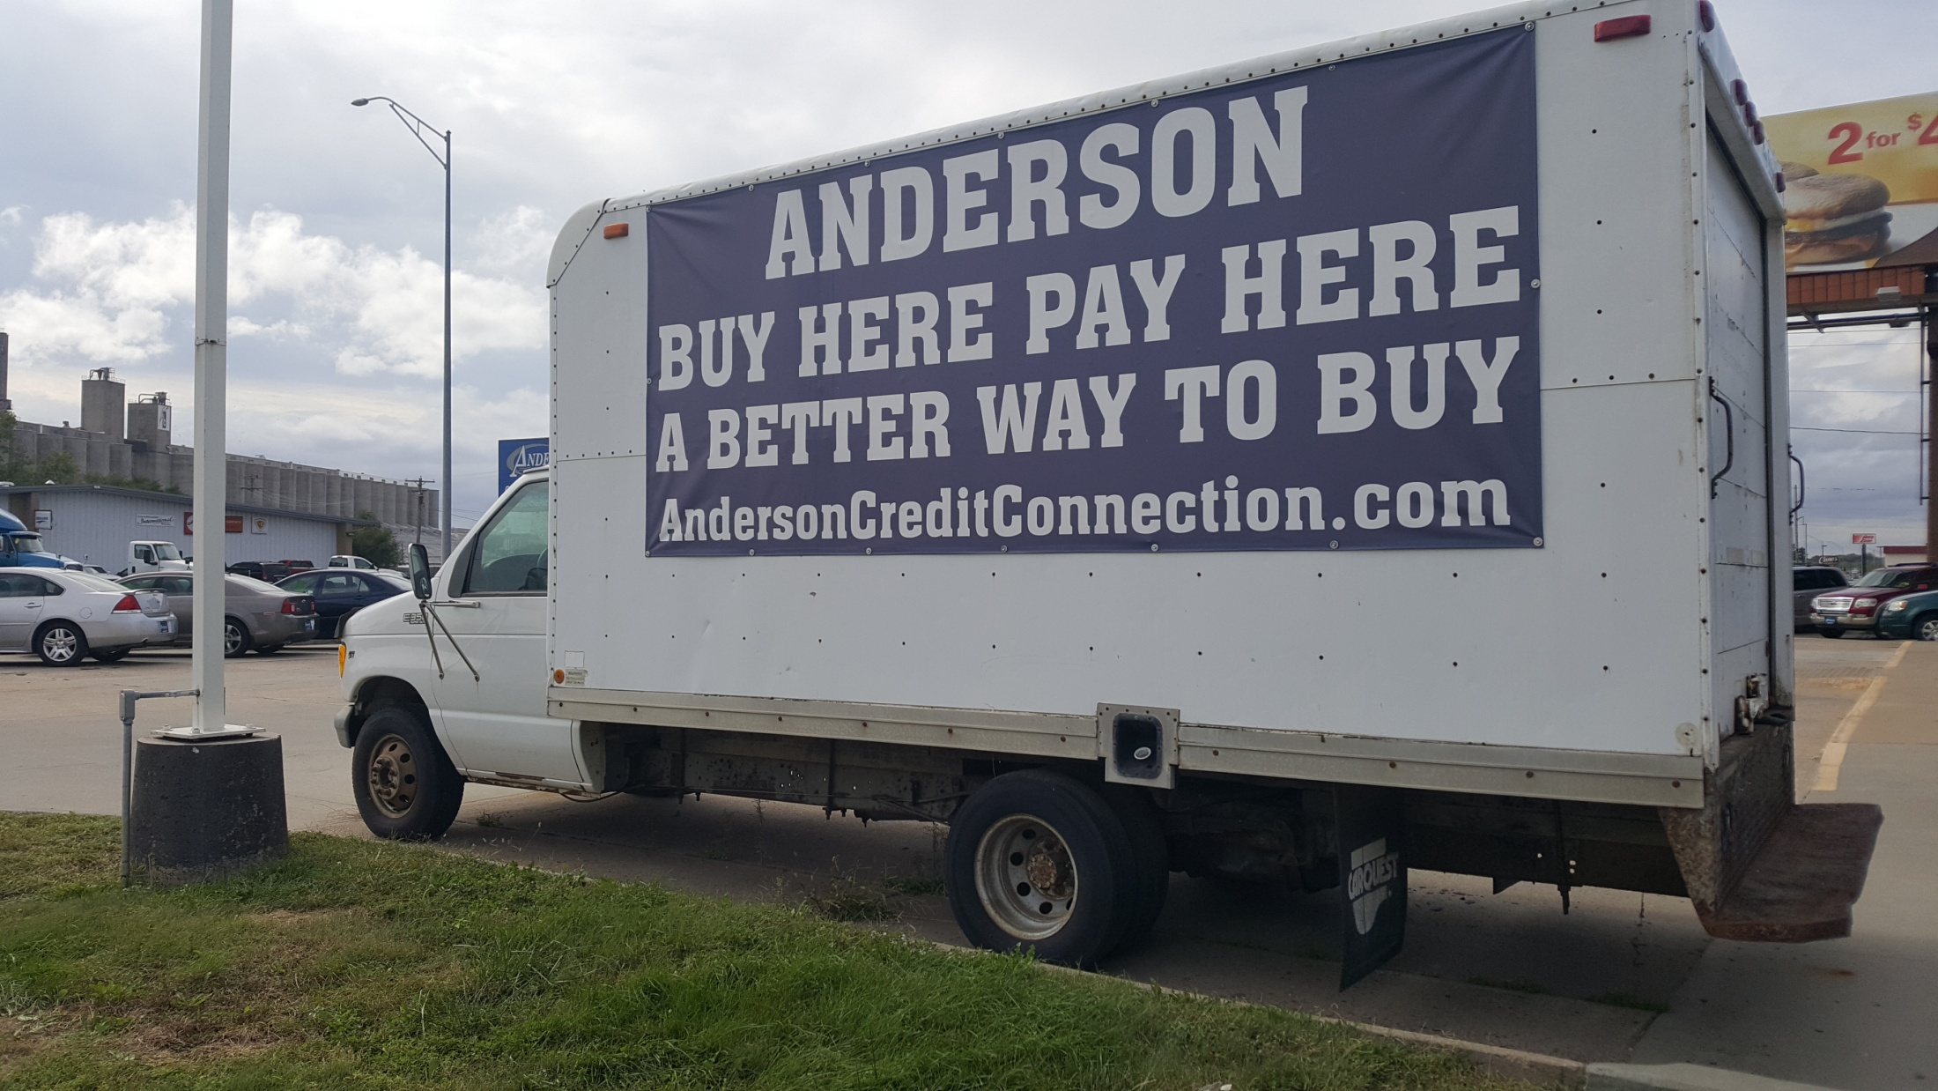
We are loading up the moving truck and moving to our new location in January 2020. We will have all of our services under one roof and with the new building we can expand our inventory and expand our ability to provide service to our current customers and our future customers.
Our New Address will be 1800 Adams St, Lincoln NE 68521

Slide 11
Expanded Service Department
5 x more space, more lifts, alignment machine, and more used car technicians
Full diagnostic auto services, engines, transmissions, etc.. We can do it all.
Oil Changes, Tires, Alignments, and Full Service Auto Detailing
Large customer lounge, with Free WIFI and TV

Slide 12
Expanded Sales
Department
More space = Double the current inventory
More space = greater selection to choose from
Kid’s area for the Kid’s to watch TV and play while you shop for a new ride
More SUV’s, More Car’s and More Van’s

Slide 13
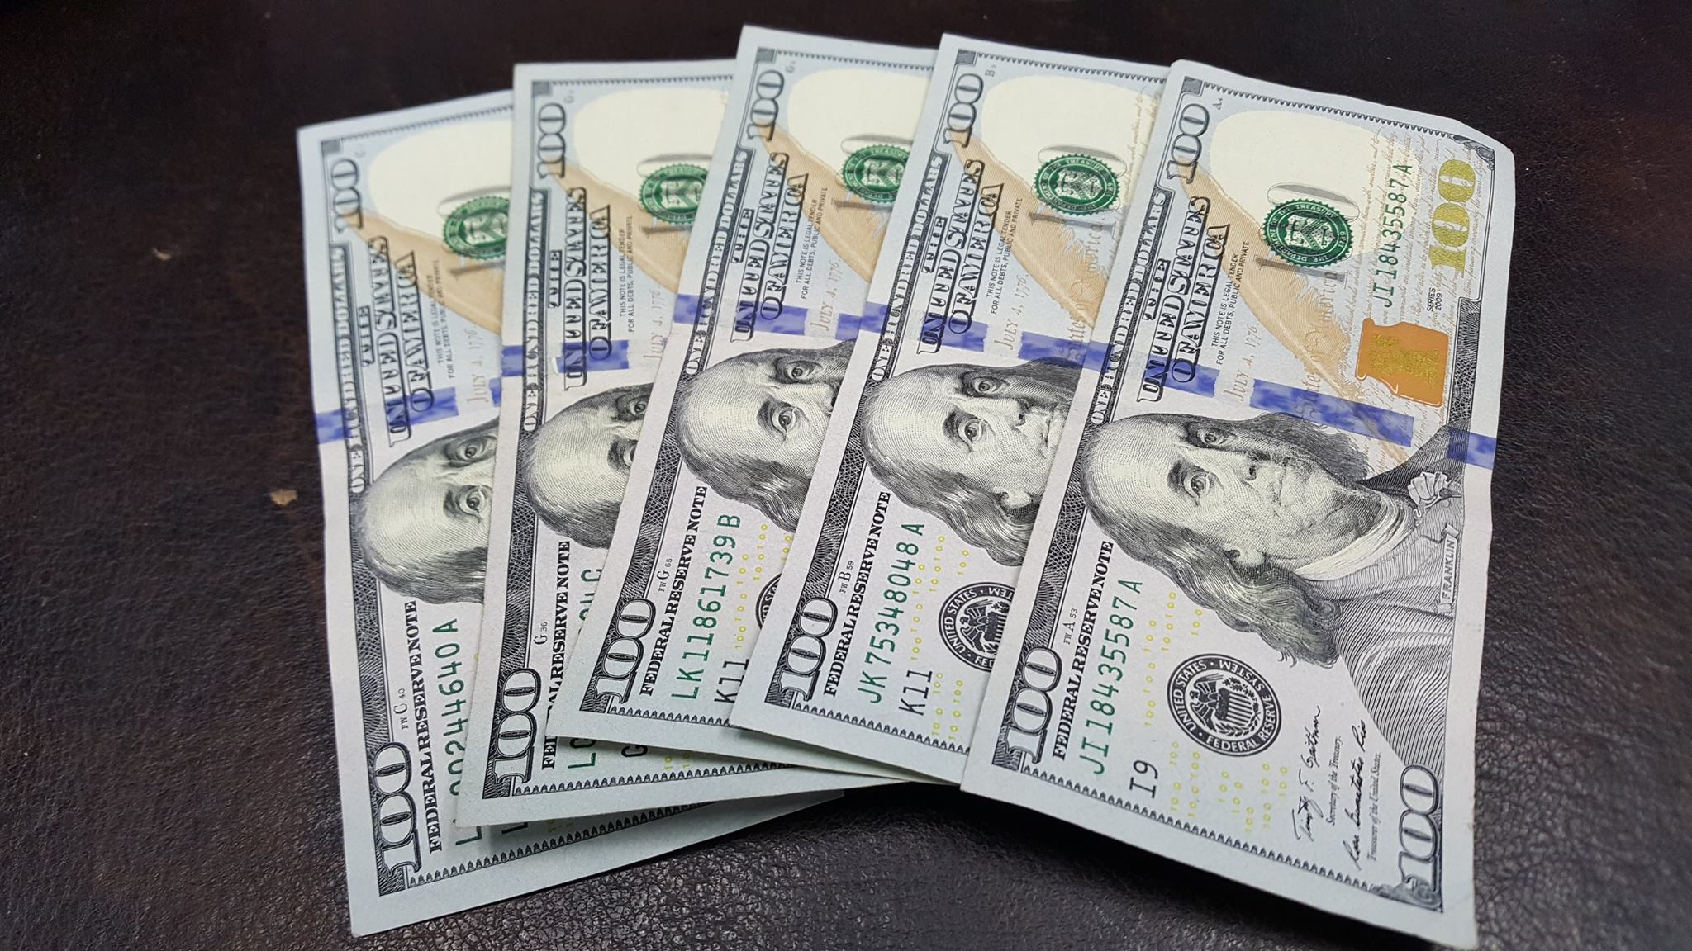
$500 Down + Provable Income = We Can Help

